Slide 1
Neural Network & Deep Learning
Dr. Malak Abdullah
Computer Science Department
Jordan University of Science and Technology

Slide 2
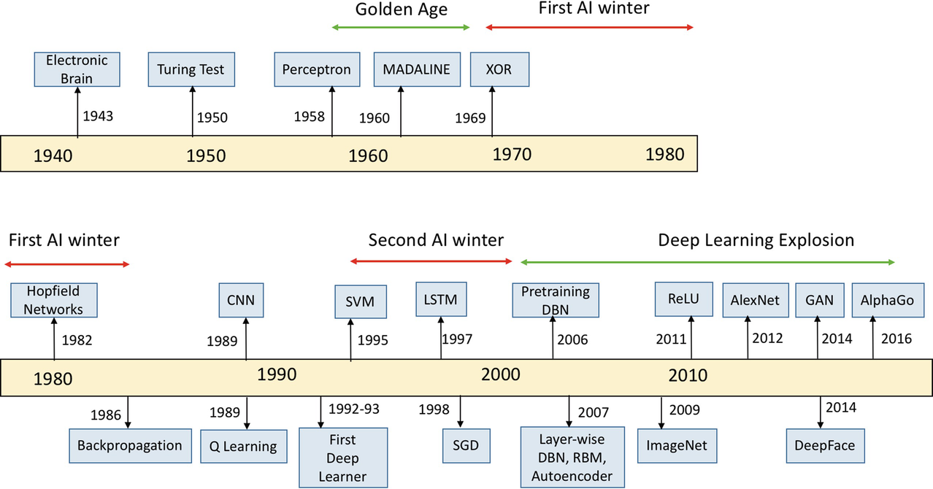

Slide 3
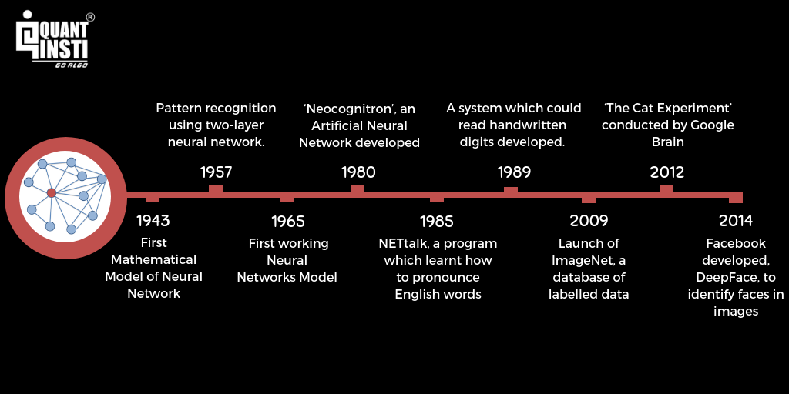

Slide 4
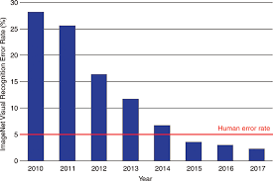
Neural Network again!
The idea of Neural Network has been around since the 1940's, and has had a few ups and downs, most notably when compared against the Support Vector Machine (SVM).
For example, the Neural Network was popularized up until the mid 90s when it was shown that the SVM, using a new-to-the-public (the technique itself was thought up long before it was actually put to use) technique, the "Kernel Trick," was capable of working with non-linearly separable datasets.
With this, the Support Vector Machine catapulted to the front again, leaving neural nets behind and mostly nothing interesting until about 2011, where Deep Neural Networks began to take hold and outperform the Support Vector Machine, using new techniques, huge dataset availability, and much more powerful computers.

Slide 5
Why NNs are getting powerful now!?
There is now a huge quantity of data available to train neural networks, and ANNs frequently outperform other ML techniques on very large and complex problems.
The tremendous increase in computing power since the 1990s now makes it possible to train large neural networks in a reasonable amount of time. This is in part due to Moore’s law (the number of components in integrated circuits has doubled about every 2 years over the last 50 years), but also thanks to the gaming industry, which has stimulated the production of powerful GPU cards by the millions. Moreover, cloud platforms have made this power accessible to everyone.
The training algorithms have been improved. To be fair they are only slightly different from the ones used in the 1990s, but these relatively small tweaks have had a huge positive impact.
ANNs seem to have entered a virtuous circle of funding and progress. Amazing products based on ANNs regularly make the headline news, which pulls more and more attention and funding toward them, resulting in more and more progress and even more amazing products.

Slide 6
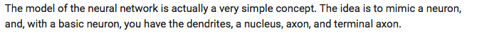
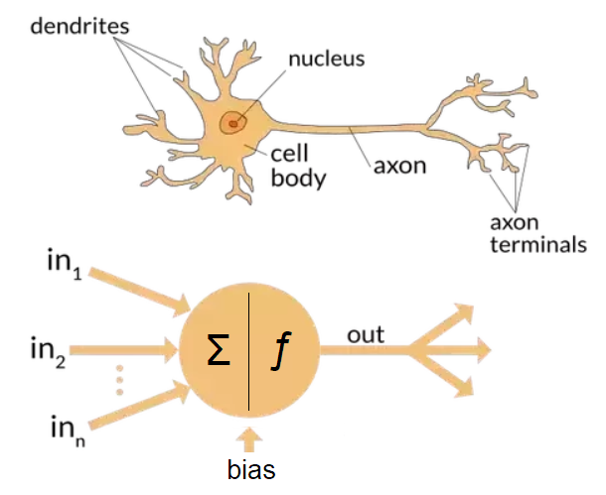

Biological Neurons
Biological neurons produce short electrical impulses as signals, which travel along the axons and make the synapses release chemical signals. When a neuron receives a sufficient amount of these signals within a few milliseconds, it fires its own electrical impulses.

Slide 7
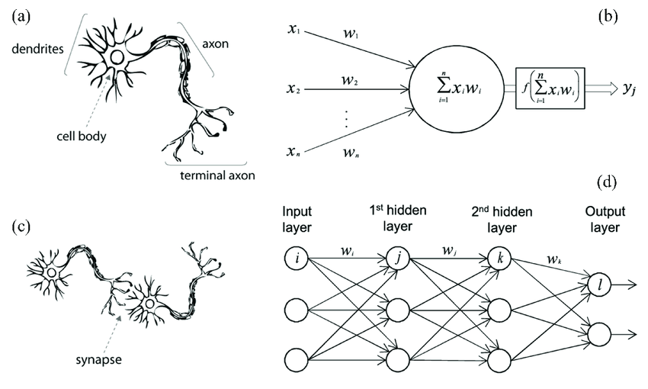
Each neuron typically connected to thousands of other neurons. Highly complex computations can be performed by a network of fairly simple neurons. It seems that neurons are often organized in consecutive layers.

Slide 8
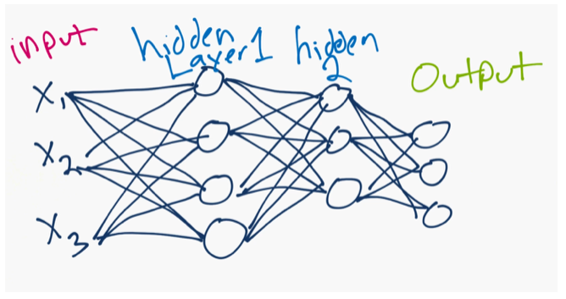
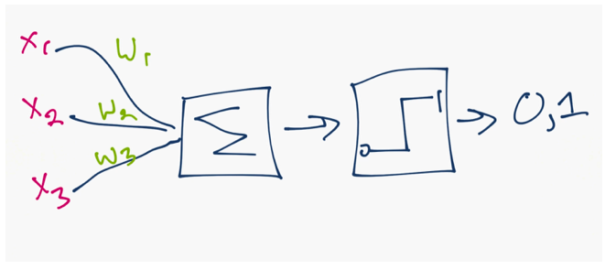
What is Neural Network
With approximately 100 billion neurons, the human brain processes data at speeds as fast as 268 mph!
A neural network is a collection of neurons connected by synapses.
This collection is organized into three main layers: the input layer, the hidden layer, and the output layer.
The circles represent neurons while the lines represent synapses.
Each layer using the output of the previous layer as its input.

Slide 9
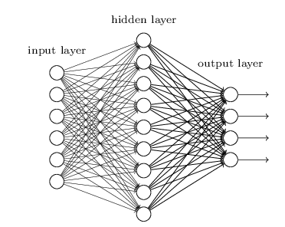
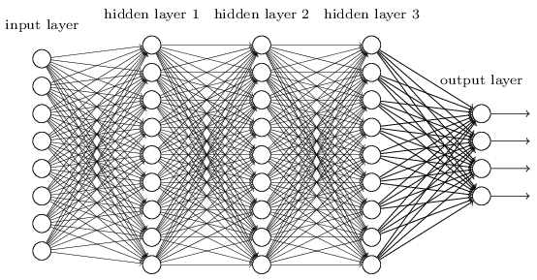
Deep Learning
You can have many hidden layers, which is where the term deep learning comes into play.
In an artificial neural network, there are several inputs, which are called features, and produce a single output, which is called a label.
Neural Network
Deep Learning

Slide 10
Deep Learning (continue)
Deep learning is a machine learning technique that teaches computers to do what comes naturally to humans: learn by example.
Deep learning is getting lots of attention lately and for good reason. It’s achieving results that were not possible before.
In deep learning, a computer model learns to perform classification tasks directly from images, text, or sound. Deep learning models can achieve state-of-the-art accuracy, sometimes exceeding human-level performance.
Models are trained by using a large set of labeled data and neural network architectures that contain many layers.
Deep learning is a key technology behind driverless cars, enabling them to recognize a stop sign, or to distinguish a pedestrian from a lamppost.

Slide 11
Why Now?
While deep learning was first theorized in the 1980s, there are two main reasons it has only recently become useful:
Deep learning requires large amounts of labeled data. For example, driverless car development requires millions of images and thousands of hours of video.
Deep learning requires substantial computing power. High-performance GPUs have a parallel architecture that is efficient for deep learning. When combined with clusters or cloud computing, this enables development teams to reduce training time for a deep learning network from weeks to hours or less.
Deep learning is being used in automated hearing and speech translation. For example, home assistance devices that respond to your voice and know your preferences are powered by deep learning applications.

Slide 12
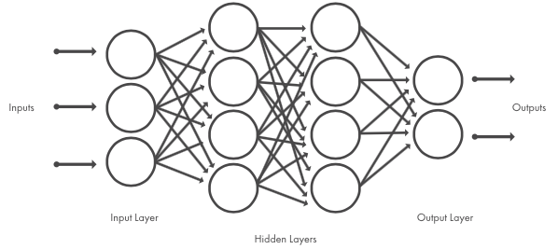
How it functions!?
Deep learning models are trained by using large sets of labeled data and neural network architectures that learn features directly from the data without the need for manual feature extraction
In machine learning, you manually choose features and a classifier to sort images. With deep learning, feature extraction and modeling steps are automatic.
When choosing between machine learning and deep learning, consider whether you have a high-performance GPU and lots of labeled data. Deep learning is generally more complex, so you’ll need at least a few thousand images to get reliable results.

Slide 13
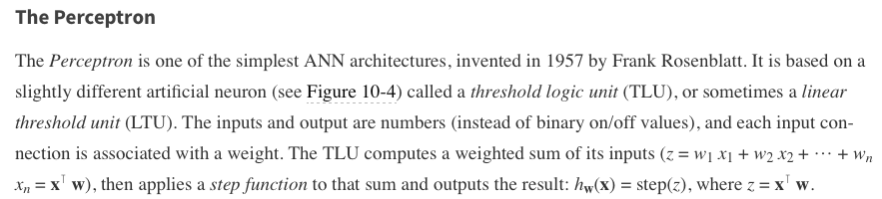
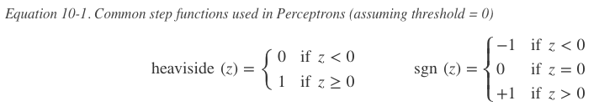
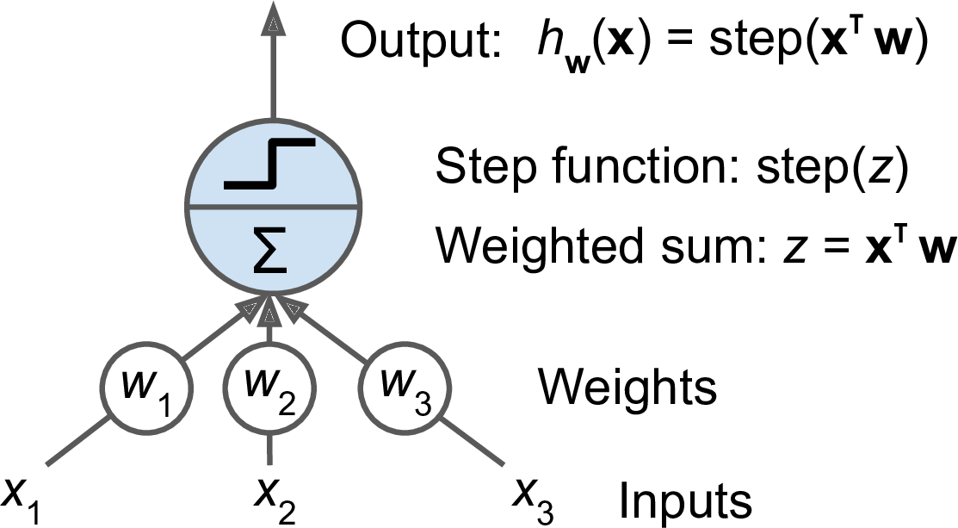
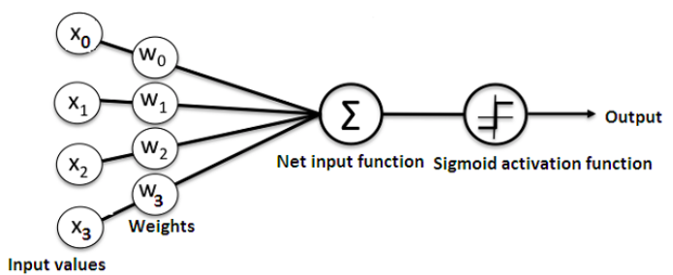
Based on LTU or TLU
Figure 10-4. Threshold logic unit: an artificial neuron which computes a weighted sum of its inputs then applies a step function

Slide 14
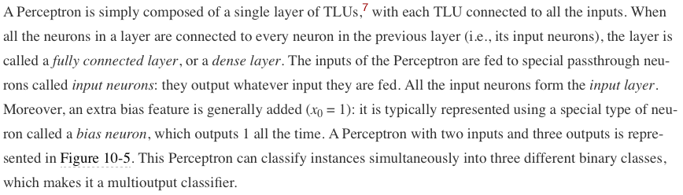
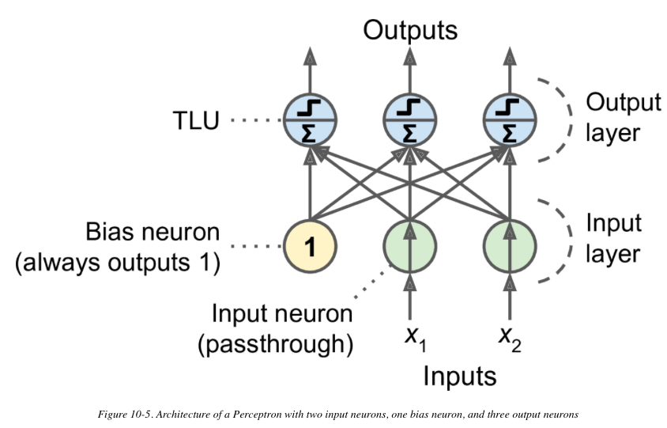
A single perceptron

Slide 15
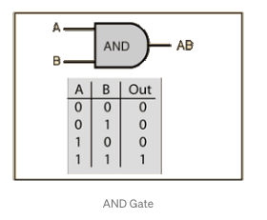
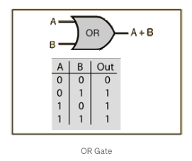
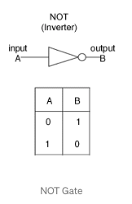
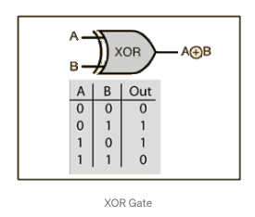
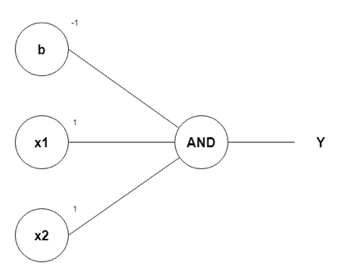
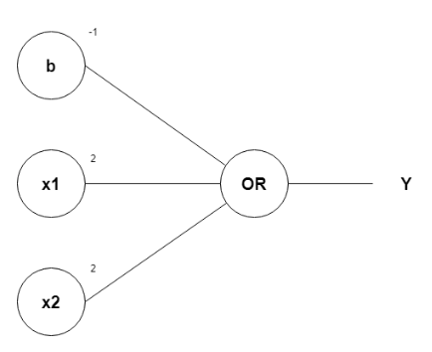
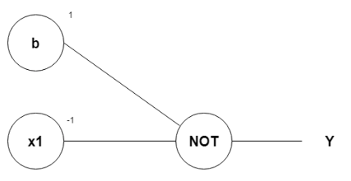
Logical Computations with Neurons
w1, w2, as 1 and b as –1
w1, w2, as 1 and b as –1
?

Slide 16
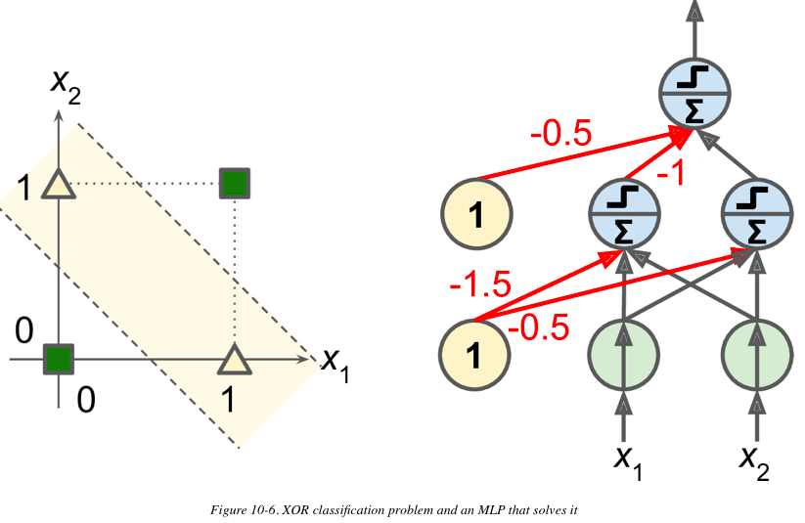
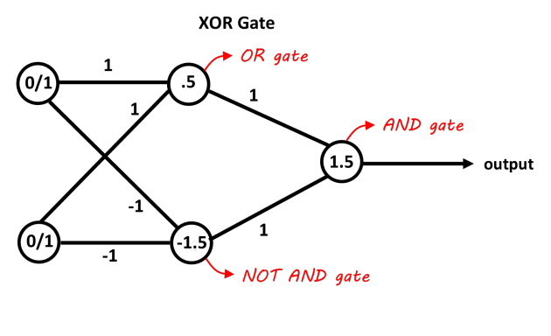
Weakness of Perceptron
In their 1969 monograph Perceptrons, some researchers highlighted a number of serious weaknesses of Perceptrons—in particular, the fact that they are incapable of solving some trivial problems (e.g., the Exclusive OR (XOR) classification problem)
It turns out that some of the limitations of Perceptrons can be eliminated by stacking multiple Perceptrons. The resulting ANN is called a Multilayer Perceptron (MLP).
An MLP can solve the XOR problem
1
1
1
1
1

Slide 17
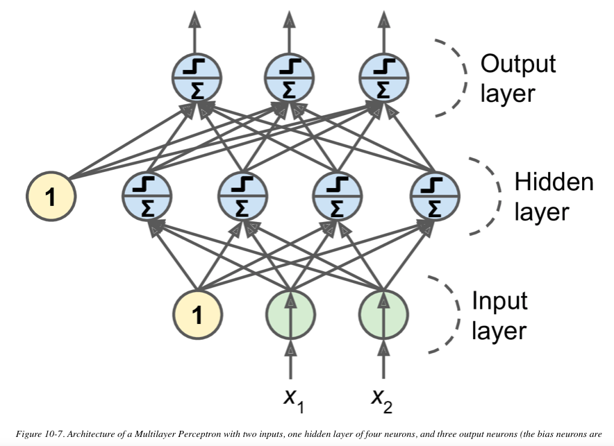
The MLP and Backpropagation
An MLP is composed of one (passthrough) input layer, one or more layers of TLUs, called hidden layers, and one final layer of TLUs called the output layer.
The layers close to the input layer are usually called the lower layers, and the ones close to the outputs are usually called the upper layers. Every layer except the output layer includes a bias neuron and is fully connected to the next layer.
When an ANN contains a deep stack of hidden layers, it is called a deep neural network (DNN).
The field of Deep Learning studies DNNs, and more generally models containing deep stacks of computations. Even so, many people talk about Deep Learning whenever neural networks are involved (even shallow ones).

Slide 18
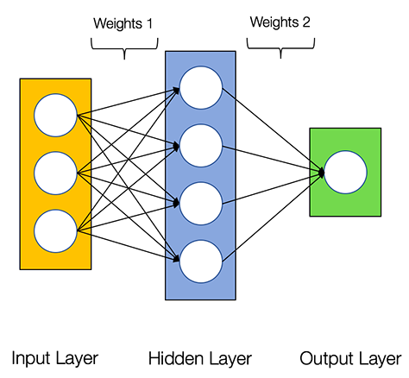
Artificial Neural Network (ANN)
Basically, an ANN comprises of the following components:
An input layer that receives data and pass it on (X)
A hidden layer or more
An output layer (Y)
Weights and biases between the layers (W, b)
A choice of activation function for each hidden layer.
There are several types of neural networks. We are going to create the feed-forward or perception neural networks. This type of ANN relays data directly from the front to the back.

Slide 19
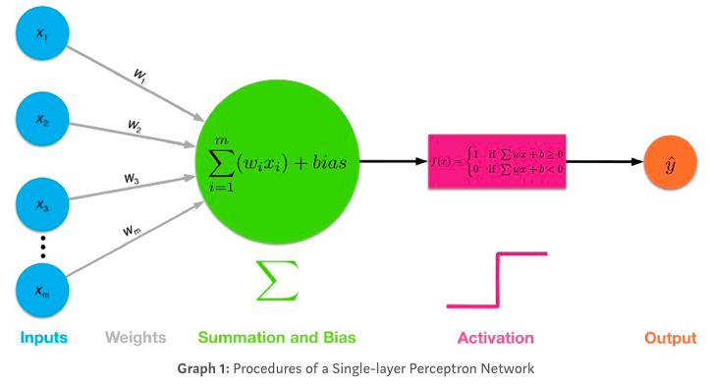
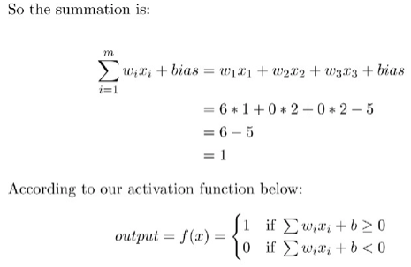
Example
Example: you need to decide whether to study DL or not?
If you will earn more money after mastering DL (Yes: 1, No: 0)
Is the relevant mathematics and programming easy (Yes: 1, No: 0)
You can work on DL immediately without the need for an expensive GPU (Yes: 1, No: 0)
Your preference is (1, 0 , 0)
Let’s go for w1 = 6, w2 = 2, w3 = 2. The larger the weight, the more influential the corresponding input is.
We’ll assume the threshold value = 5, which is equivalent to say that the bias term bias = -5.

Slide 20
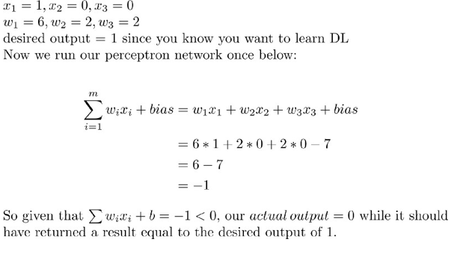
Adjusting weights
In a real DL model, we are given input data, which we can’t change.
The bias term is initialized before you train your neural networks model. Suppose the bias is 7.
Now, let’s assume the following input data so that (1)You will earn more money, (2) math and programming for DL will be hard, and (3) yes you have to spend $1400 for a GPU to work on DL, and most importantly, we assume that you actually want to learn deep learning, which we’ll name as the desired output (1, 0, 0 → 1 )
We can not change the input
We can not change the desired output
So ???

Slide 21
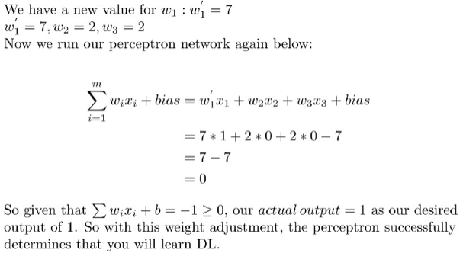
Adjusting the weights is the key to the learning process
Lets increase w1 to 7, without changing w2 and w3, then
backpropagation for the network is to learn from trials and errors

Slide 22
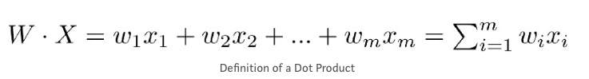
Learning ☺
If we start with random weights, perceptron will try to learn to adjust and find the ideal weights (w1 = 6, w2 = 2, w3 = 2)
With m features in input X, you need m weights to perform a dot product
With n hidden neurons in the hidden layer, you need n sets of weights (W1, W2, … Wn) for performing dot products
With 1 hidden layer, you perform n dot products to get the hidden output h: (h1, h2, …, hn)
Then it’s just like a single-layer perceptron, we use hidden output h: (h1, h2, …, hn) as input data that has n features, perform dot product with 1 set of n weights (w1, w2, …, wn) to get your final output y_hat.

Slide 23
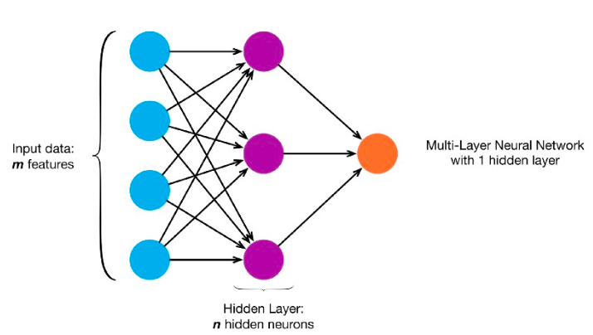
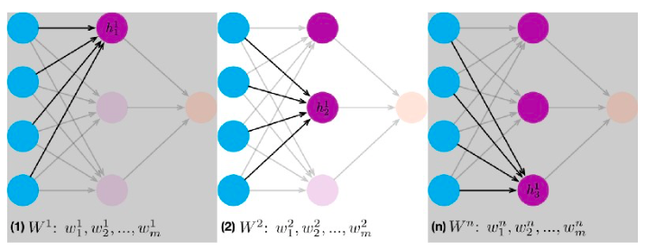

Slide 24
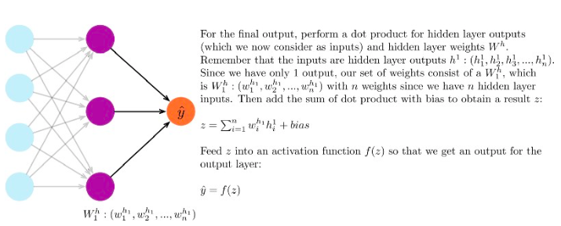

Slide 25
Activation functions g
Threshold
Sigmoid 1/(1+e^{-x})

Slide 26
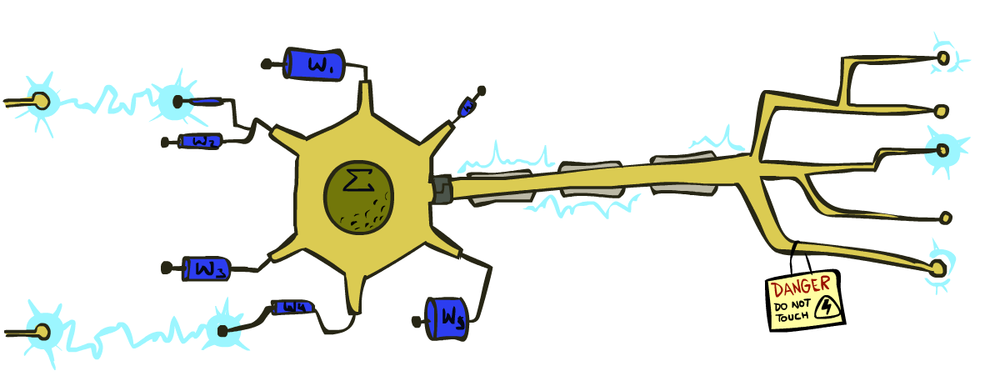
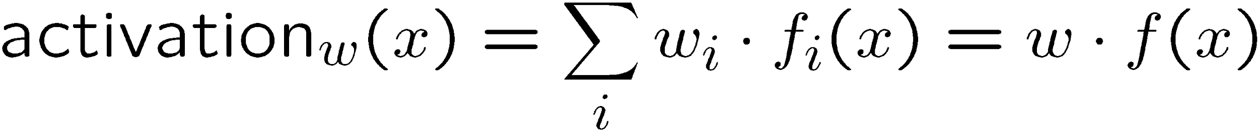
Reminder: Linear Classifiers
Inputs are feature values
Each feature has a weight
Sum is the activation
If the activation is:
Positive, output +1
Negative, output -1
w₁
f₁
Σ
w₂
>0?
f₂
w₃
f₃

Slide 27
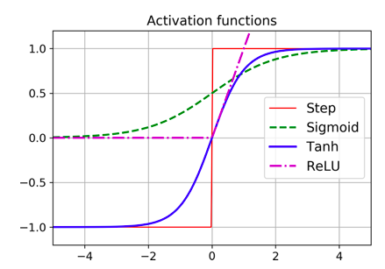
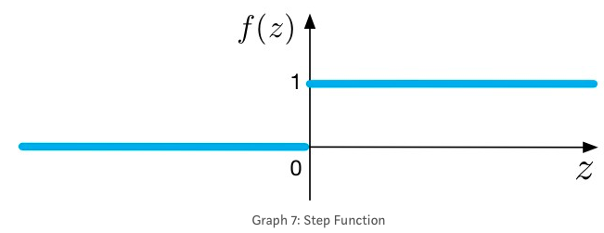
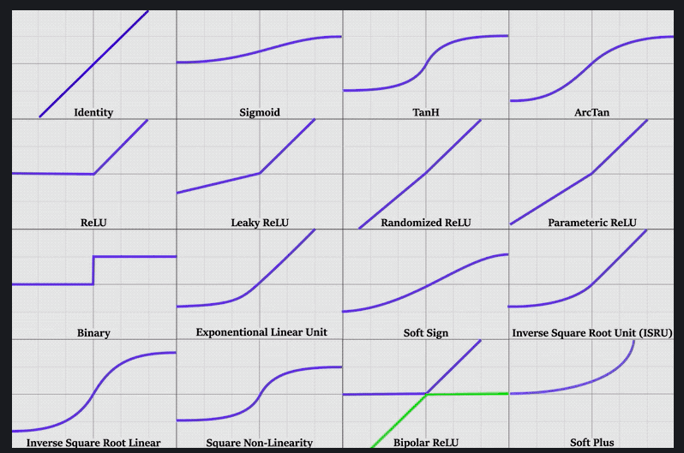
Activation Functions
step function
Sigmoid
TanH
ReLU
and more

Slide 28
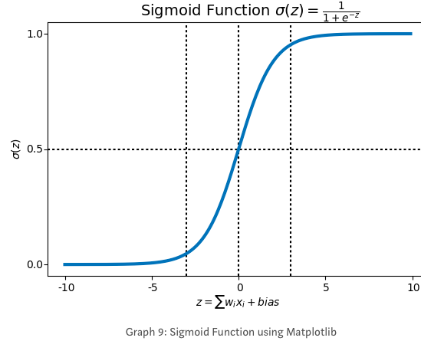
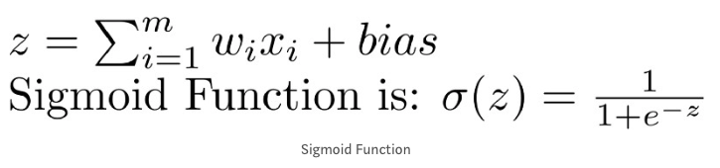
Sigmoid Activation function
Step Function (0 or 1) while sigmoid function is ?!?
Draws a characteristic “S”-shaped curve, as an activation function to the neural network.
This function can map any value to a value from 0 to 1. It will assist us to normalize the weighted sum of the inputs.
we want a learning algorithm that could improve our neural network by gradually changing the weights, not sudden jumps

Slide 29
Sigmoid function
Sigmoid function produces similar results to step function in that the output is between 0 and 1. The curve crosses 0.5 at z=0, which we can set up rules for the activation function, such as: If the sigmoid neuron’s output is larger than or equal to 0.5, it outputs 1; if the output is smaller than 0.5, it outputs 0.
Sigmoid function is smooth and it has a very nice and simple derivative of σ(z) * (1-σ(z)), which is differentiable everywhere on the curve. You don’t have to know how to derive it. No stress here.
If z is very negative, then the output is approximately 0; if z is very positive, the output is approximately 1; but around z=0 where z is neither too large or too small, we have relatively more deviation as z changes.
This non-linear activation function, when used by each neuron in a multi-layer neural network, produces a new “representation” of the original data

Slide 30
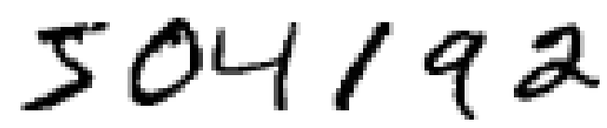
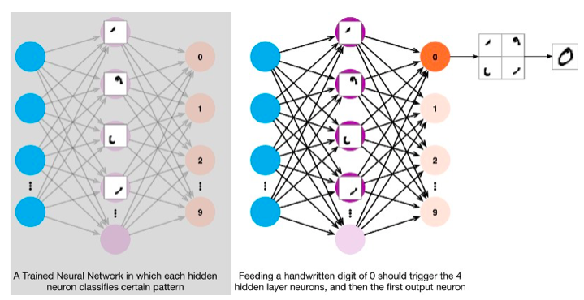
You and I have no clue what’s going on in the neural network until after the network is trained.
A trained neural network has weights which are optimized at certain values that make the best prediction or classification on our problem. It’s a black box.

Slide 31
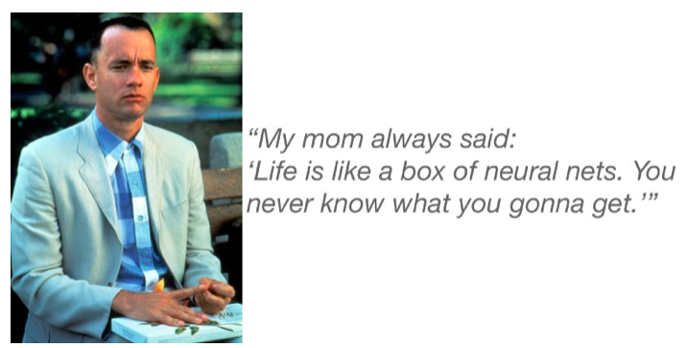
https://towardsdatascience.com/multi-layer-neural-networks-with-sigmoid-function-deep-learning-for-rookies-2-bf464f09eb7f

Slide 32
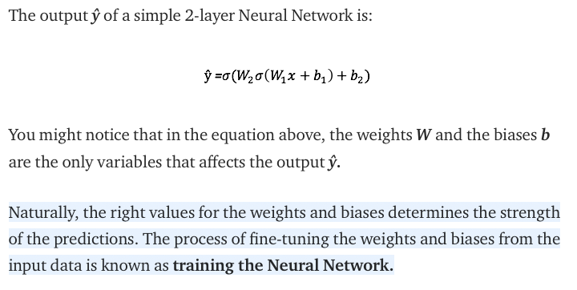
To sum up

Slide 33
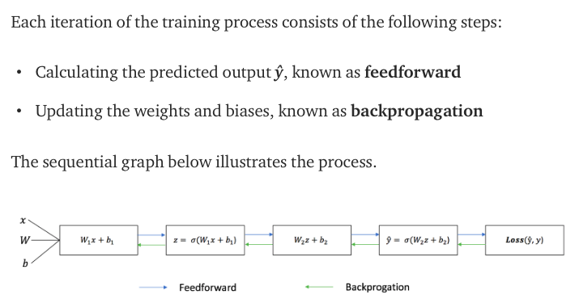

Slide 34
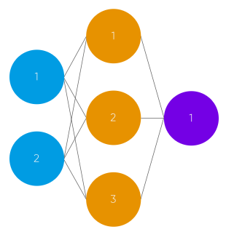
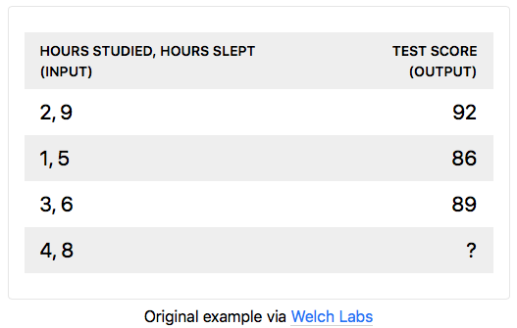
Building NN from Scratch
The neural network will model a single hidden layer with two inputs and one output.
In the network, we will be predicting the score of our exam based on the inputs of how many hours we studied and how many hours we slept the day before. Our test score is the output.

Slide 35

normalizing
We want all the input and output to have values between 0 and 1
scale our data by dividing by the maximum value for each variable.

Slide 36

Random Weights
The input are (study 2 hours, sleep 9 hours)
We will generate random weights
0.2, 0.6, 0.1, 0.8 , 0.3, and 0.7
(2 * .2) + (9 * .8) = 7.6
(2 * .6) + (9 * .7) = 7.5
(2 * .1) + (9 * .7) = 6.5
We need to apply the activation function to
map the results from 0 to 1
There are many activation functions out there. The more popular ones - the sigmoid function.
.7

Slide 37


Sigmoid
S(7.6) = 0.999499799
S(7.5) = 1.000553084
S(6.5) = 0.998498818
(.9994 * .4) + (1.000 * .5) + (.9984 * .9) = 1.79832
S(1.79832) = .8579443067 → this is our first prediction
However, our target was 0.92.
Voila , THIS IS FEED FORWARD!!!

Slide 38



Coding!!

Slide 39
How to improve the prediction
Here’s a brief overview of how a simple feedforward neural network works:
Takes inputs as a matrix (2D array of numbers)
Multiplies the input by a set weights
Applies an activation function
Returns an output
Error is calculated by taking the difference from the desired output from the data and the predicted output. This creates our gradient descent, which we can use to alter the weights
The weights are then altered slightly according to the error.
To train, this process is repeated 1,000+ times. The more the data is trained upon, the more accurate our outputs will be.

Slide 40
Backpropagation
The “learning” of our network
Backpropagation is the heart of every neural network ☺
There is no pure backpropagation or pure feed-forward neural network.
Backpropagation is algorithm to train (adjust weight) of neural network.
Backpropagation works by using a loss (or cost) function to calculate how far the network was from the target output.

Slide 41

Backpropagation
Calculating error: One way of representing the loss function is by using the mean sum squared loss function:
our goal is to get it as close as we can to 0. That means we will need to have close to no loss at all. As we are training our network, all we are doing is minimizing the loss.
To figure out which direction to alter our weights, we need to find the rate of change of our loss with respect to our weights. In other words, we need to use the derivative of the loss function to understand how the weights affect the input. Here comes: gradient descent
n: number of observations

Slide 42


Gradient descent
Minimizing any function means finding the deepest valley in that function.
Analogically this can be seen as, walking down into a valley, trying to find gold(the lowest error value).
Using calculus, we know that the slope of a function is the derivative of the function with respect to a value. This slope always points to the nearest valley!
Now that we have found the direction we need to increment/decrement the weight, we need to find how much !!!. Here, we use the Learning Rate.
can be learned mostly by trial and error.

Slide 43

The backpropagation code

Slide 44


Slide 45




Slide 46

Learning rule for adjusting weights
This is called the Perceptron convergence theorem

Slide 47
Build a model
from keras.models import Sequential
from keras.layers import Dense, Dropout, Activation
model = Sequential()
The first thing to get right is to ensure the input layer has the right number of inputs.
How do we know the number of layers and their types?
This is a very hard question. There are heuristics that we can use and often the best network structure is found through a process of trial and error experimentation.
Generally, you need a network large enough to capture the structure of the problem if that helps at all.

Slide 48

Fully connected layers are defined using the Dense class. We can specify the number of neurons in the layer as the first argument, the initialization method as the second argument as init and specify the activation function using the activation argument.
For our previous example about iris flowers dataset. We have 4 features and 3 output classes

Slide 49
The network topology of this simple one-layer neural network can be summarized as:
4 input → (1 hidden layer with 8 neurons) → 3 output
# create model
model = Sequential()
model.add(Dense(8, input_dim=4, activation='relu'))
model.add(Dense(3, activation=‘softmax’))
model.compile(loss='categorical_crossentropy', optimizer='adam', metrics=['accuracy'])
model.fit(X, Y, epochs=150, batch_size=5)
Compiling the model uses the efficient numerical libraries under the covers such as Theano or TensorFlow. The backend automatically chooses the best way to represent the network for training and making predictions to run on your hardware, such as CPU or GPU or even distributed.
Again, these can be chosen experimentally by trial and error.

Slide 50

Notice that the Dense layer initialized the connection weights randomly, and the biases were initialized to zeros, which is fine. If you ever want to use a different initialization method, you can set kernel_initializer (kernel is another name for the matrix of connection weights) or bias_initializer when creating the layer.

Slide 51
Epoch and batch size
Epoch: all the training examples have been processed a single time. An epoch is one forward pass and one backward pass of all training examples.
One epoch consists of one full training cycle on the training set. Once every sample in the set is seen, you start again - marking the beginning of the 2nd epoch.
Sometimes, you can’t pass the entire dataset into the neural net at once. So, you divide dataset into Number of Batches or sets or parts.
batch_size determines the number of samples in each mini batch. Its maximum is the number of all samples, which makes gradient descent accurate, the loss will decrease towards the minimum if the learning rate is small enough, but iterations are slower. Its minimum is 1, resulting in stochastic gradient descent: Fast but the direction of the gradient step is based only on one example, the loss may jump around. batch_size allows to adjust between the two extremes: accurate gradient direction and fast iteration. Also, the maximum value for batch_size may be limited if your model + data set does not fit into the available (GPU) memory.

Slide 52


Evaluation and validation
You can see that the training loss went down, which is a good sign, and the validation accuracy reached 89.26% after 30 epochs. That’s not too far from the training accuracy, so there does not seem to be much overfitting going on.

Slide 53

Another example
https://machinelearningmastery.com/tutorial-first-neural-network-python-keras/

Slide 54


Slide 55

Avoiding Overfitting Through
Popular regularization techniques for neural networks:
dropout
At every training step, every neuron (including the input neurons, but always excluding the output neurons) has a probability p of being temporarily “dropped out,” meaning it will be entirely ignored during this training step, but it may be active during the next step
If you observe that the model is overfitting, you can increase the dropout rate. Conversely, you should try decreasing the dropout rate if the model underfits the training set.

Slide 56


Slide 57


Slide 58


Slide 59

Code

Slide 60
How to Create and Train Deep Learning Models
To train a deep network from scratch, you gather a very large labeled data set and design a network architecture that will learn the features and model. This is good for new applications, or applications that will have a large number of output categories. This is a less common approach because with the large amount of data and rate of learning, these networks typically take days or weeks to train.
Transfer learning is a technique where a deep learning model trained on a large dataset is used to perform similar tasks on another dataset.
Transfer Learning: Most deep learning applications use the transfer learning approach, a process that involves fine-tuning a pretrained model. You start with an existing network, such as AlexNet or GoogLeNet, and feed in new data containing previously unknown classes. After making some tweaks to the network, you can now perform a new task, such as categorizing only dogs or cats instead of 1000 different objects. This also has the advantage of needing much less data (processing thousands of images, rather than millions), so computation time drops to minutes or hours.

Slide 61
Reusing Pretrained Layers
It is generally not a good idea to train a very large DNN from scratch: instead, you should always try to find an existing neural network that accomplishes a similar task to the one you are trying to tackle.
Then reuse the lower layers of this network. This technique is called transfer learning. It will not only speed up training considerably, but also require significantly less training data.
Suppose you have access to a DNN that was trained to classify pictures into 100 different categories, including animals, plants, vehicles, and everyday objects. You now want to train a DNN to classify specific types of vehicles. These tasks are very similar, even partly overlapping, so you should try to reuse parts of the first network.
The output layer of the original model should usually be replaced because it is most likely not useful at all for the new task, and it may not even have the right number of outputs for the new task.
Similarly, the upper hidden layers of the original model are less likely to be as useful as the lower layers, since the high-level features that are most useful for the new task may differ significantly from the ones that were most useful for the original task. You want to find the right number of layers to reuse.

Slide 62


Slide 63
references
https://pythonprogramming.net/neural-networks-machine-learning-tutorial/
https://towardsdatascience.com/introducing-deep-learning-and-neural-networks-deep-learning-for-rookies-1-bd68f9cf5883
https://towardsdatascience.com/multi-layer-neural-networks-with-sigmoid-function-deep-learning-for-rookies-2-bf464f09eb7f
https://enlight.nyc/projects/neural-network/
https://towardsdatascience.com/how-to-build-your-own-neural-network-from-scratch-in-python-68998a08e4f6
https://www.kdnuggets.com/2018/10/simple-neural-network-python.html
https://medium.com/@UdacityINDIA/how-to-build-your-first-neural-network-with-python-6819c7f65dbf
https://www.analyticsvidhya.com/blog/2017/05/neural-network-from-scratch-in-python-and-r/

